Slide 1
UNIVERSITY INSTITUTE OF ENGINEERING
Department of Computer Science & Engineering
Databases Management System
(23CSH-205/23ITH-205)
DR. GITANJALI
E16525
ASSISTANT PROFESSOR
CSE
DISCOVER . LEARN . EMPOWER

Slide 2
ABOUT COURSE
The main DBMS course, we learn about the structural formation of data, maintain data integrity, multitasking with concurrent access and recovery without occurring crashes, data structures, data models etc. and their working in which every organization is based.
At the end of the course, the students may understand the concepts of data structures, data models and design, construction of queries by using SQL, uses and applications of database design etc

Slide 3
COURSE OUTCOMES
CO No. | Title | BT Level
CO1 | Students will be able to understand the database system concepts and design databases for different applications. | Memorize
CO2 | Students will be able to identify different types of DDL, DML, DCL and TCL commands and their usage. | Understanding
CO3 | Students will be able to classifying Normalization, Dependencies and Denormalization along with their requirements. | Apply
CO4 | Students will be able to analyse and Compare Transaction Processing techniques and Recovery techniques. | Analyze
CO5 | Students will be able to evaluate database performance after implementing Triggers, procedures, packages, cursors and views. | Evaluate
Will be covered in this lecture

Slide 4
COURSE OBJECTIVES
This course will enable students to,
To have good understanding of database system concepts and design databases for different applications.
To learn how to use a DBMS and RDBMS.
To implement and understand different types of DDL, DML and DCL statements.
To understand transaction concepts related to databases and recovery/backup techniques required for the proper storage of data.

Slide 5
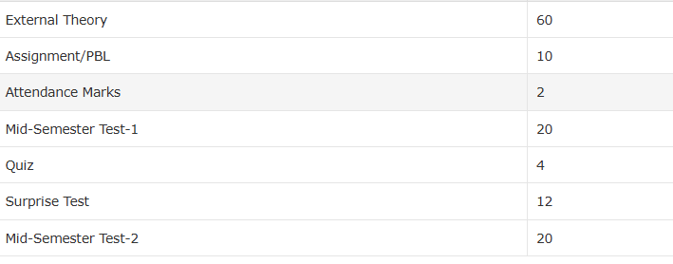
ASSESSMENT MODEL

Slide 6
SUGGESTED COURSES
Course Name | Provider | Duration | Focus Area | Link
Introduction to Databases | IBM | 27 hours | General Database Fundamentals | https://www.coursera.org/learn/introduction-to-databases
Databases and SQL for Data Science with Python | IBM | 13 hours | SQL and Data Science | https://www.coursera.org/learn/sql-data-science
SQL: A Practical Introduction for Querying Databases | IBM | 21 hours | Practical SQL Querying | https://www.coursera.org/learn/sql-practical-introduction-for-querying-databases
Introduction to NoSQL Databases | IBM | 16 hours | NoSQL Database Concepts | https://www.coursera.org/learn/introduction-to-nosql-databases
Introduction to Relational Databases (RDBMS) | IBM | 18 hours | Relational Database Fundamentals | https://www.coursera.org/learn/introduction-to-relational-databases
Relational Database Administrator (DBA) | IBM | Not Specified | Database Administration | https://www.coursera.org/learn/relational-database-administration

Slide 7
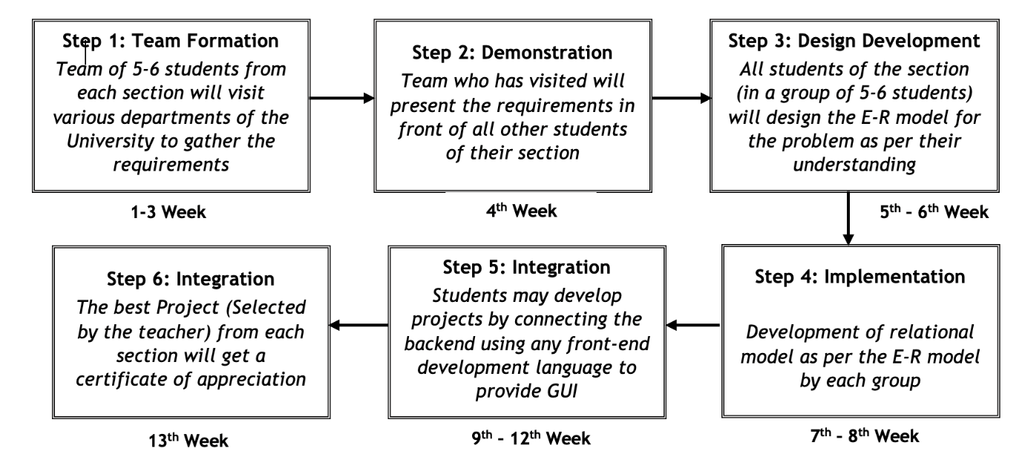
Activity based learning

Slide 8




Have you ever heard of !
Top Companies:
Google: Known for paying $139,000–$185,000 for data-related roles.
Meta (Facebook): Offers $150,000–$193,000 for big data engineers​
Microsoft and Amazon: Regularly hire database professionals with competitive packages exceeding $100,000 for experienced hires​

Slide 9

Highest Salaries Package
Highest Salaries:
Senior Database Administrator: $99,500–$137,000 annually​
Big Data Engineer: Base salaries range from $139,000–$193,000 at top companies like Google and Meta​
.
Data Architect: Senior roles often earn up to $130,000 annually, reflecting the demand for designing and managing large-scale data systems​
Springboard
​
Data Engineer: Salaries for mid-level engineers are around $106,000, with senior roles exceeding $137,000​

Slide 10
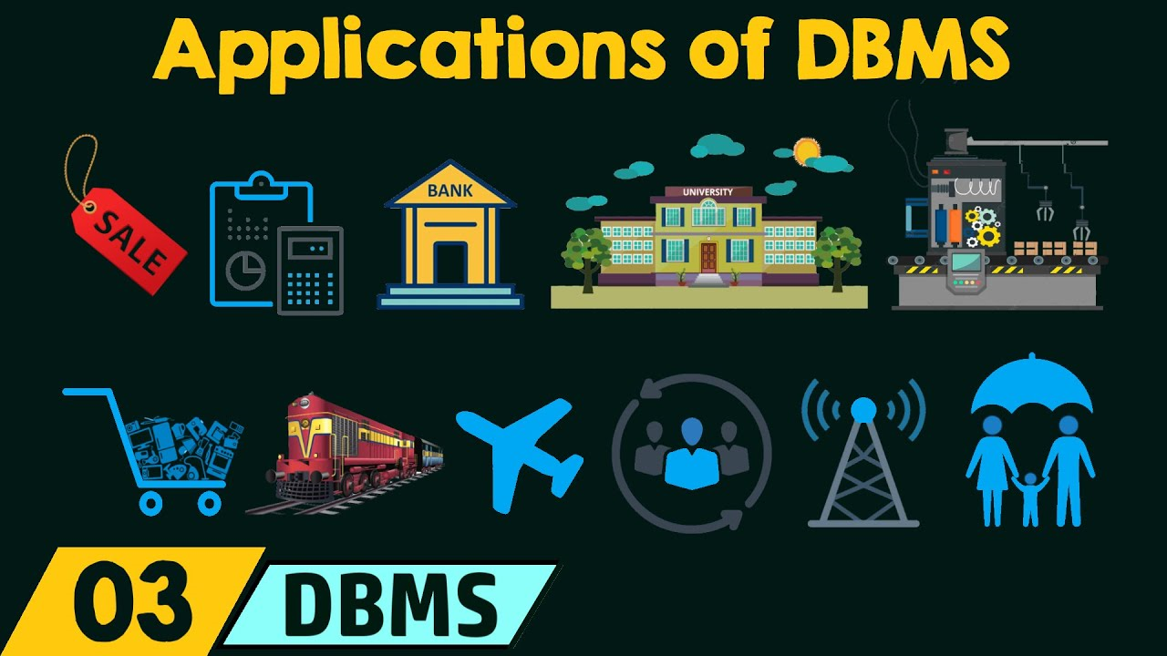
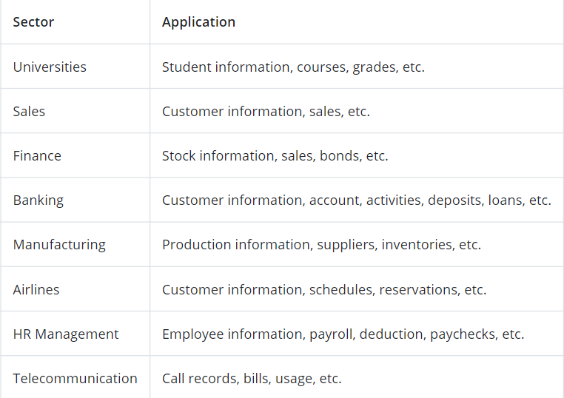
Applications of DBMS

Slide 11
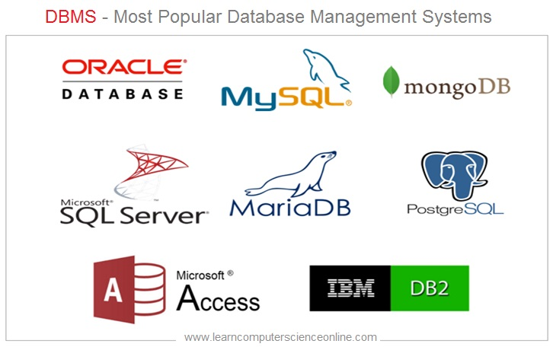

Slide 12
Topics covered
Overview of Databases:
Database concepts, DBMS, Data Base System Architecture (Three Level ANSI-SPARC Architecture), Advantages and Disadvantages of DBMS, Data Independence, DBA and Responsibilities of DBA, Relational Data Structure, Keys, Relations, Attributes, Schema and Instances, Referential integrity, Entity integrity.

Slide 13
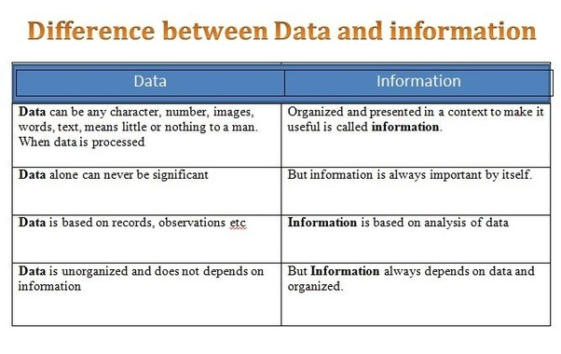
Difference between Data and Information

Slide 14

Database Concepts
A Database is a collection of related data organized to serve multiple applications.
Example: A library database containing details about books, members, and borrowing records.

Slide 15
Why DBMS is important?
Purpose of Database System
In DBMS, database systems provide a safe and effective platform to manage vast amounts of data. Their role is to provide services like data organization, storage, and manipulation, as well as to guarantee data integrity. A database system’s primary goal is to facilitate data retrieval and provide a dependable storage platform for essential data.
A Database Management System (DBMS) is crucial in modern computing for the following reasons:
1. Efficient Data Management
DBMS provides a systematic way to store, organize, and manage large amounts of data.
It eliminates redundancy and ensures consistency in data.
2. Data Security
DBMS offers tools to restrict unauthorized access and ensures data integrity through user authentication and encryption.
It allows role-based access, where specific permissions are granted based on user roles.

Slide 16
Why DBMS is important?
3. Data Integrity and Accuracy
Ensures the accuracy and reliability of data through integrity constraints and validation rules.
Prevents inconsistencies, such as duplication or outdated data.
4. Simplifies Data Access
Provides a user-friendly interface for querying, updating, and managing data.
Query languages like SQL enable users to retrieve specific data efficiently without needing technical expertise in programming.
5. Concurrency Control
DBMS allows multiple users to access and manipulate data simultaneously without conflicts, ensuring smooth multitasking and collaboration.
6. Backup and Recovery
Automates data backup processes and provides robust recovery mechanisms to restore data after accidental deletion or system failure.

Slide 17

Traditional File System
The traditional file system is a method of organizing and managing data using files. It was widely used before the emergence of Database Management Systems (DBMS). In this system, data is stored in individual files created by specific applications, and each file operates independently.
Disadvantages of Traditional File System
Data Redundancy: Multiple copies of the same data lead to inconsistencies.
Data Inconsistency: Difficult to maintain uniform data across files.
Poor Security: No built-in mechanisms to protect data from unauthorized access.
Limited Query Capability: Querying and data retrieval are slow and manual.

Slide 18

Database Management System
DBMS (Database Management System):
A Database Management System (DBMS) is software that enables users to create, manage, and interact with databases, ensuring efficient data storage, retrieval, security, and integrity while supporting multiple users and applications simultaneously. Examples include MySQL and Oracle.

Slide 19
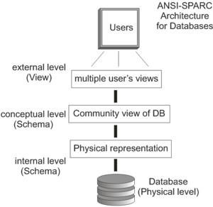
Database System Architecture
Database System Architecture:
Database system architecture refers to the design and organization of a database system, defining how data is stored, managed, and accessed by users and applications.
The ANSI-SPARC (American National Standards Institute - Standards Planning and Requirements Committee) architecture defines a three-level abstraction model for database systems. It separates database design into three distinct layers to enhance flexibility, data independence, and security.

Slide 20
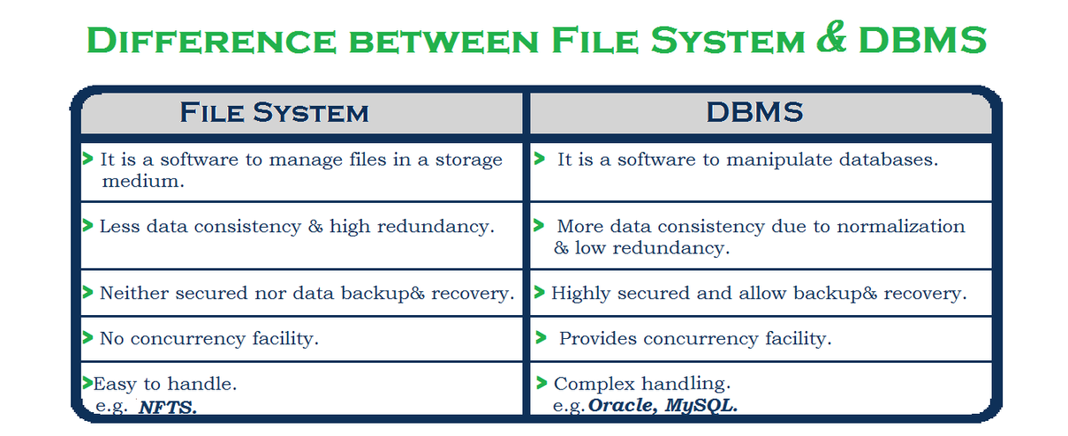
Traditional File System vs DBMS

Slide 21
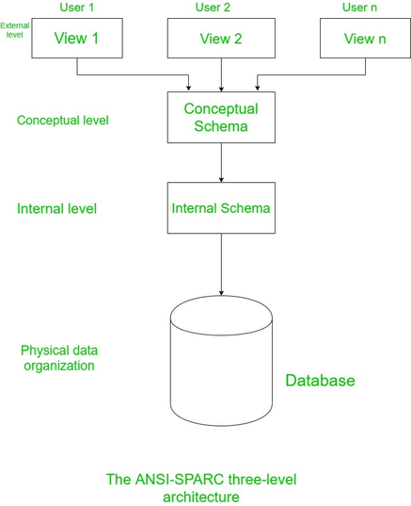
Database System Architecture
Three-Level ANSI-SPARC Architecture
External level (User view): It is the view how the user views the database. The data of the database that is relevant to that user is described at this level. The external level consists of several different external views of the database. In the external view only that entities, attributes, and relationships are included that the user wants.

Slide 22
Database System Architecture
Three-Level ANSI-SPARC Architecture
Conceptual level: It is the community view of the database and describes what data is stored in the database and represents the entities, their attributes, and their relationships. It represents the semantic, security, and integrity information about the data. The middle-level or the second-level in the three-level architecture is the conceptual level. This level contains the logical structure of the entire database, it represents the complete view of the database that the organization demands independent of any storage consideration.

Slide 23
Database System Architecture
Three-Level ANSI-SPARC Architecture
Internal level: At the internal level, the database is represented physically on the computer. It emphasizes the physical implementation of the database to do storage space utilization and to achieve the optimal runtime performance, and data encryption techniques. It interfaces with the operating system to place the data on storage files and build the storage space, retrieve the data, etc.

Slide 24
Mapping between views
Three view-levels are described by means of three schemas.
These schemas are stored in the data dictionary.
In DBMS, each user refers only to its own external schema.
Hence, the DBMS must transform a request on. a specified external schema into a request against conceptual schema, and then into a request against internal schema to store and retrieve data to and from the database.
The process to convert a request (from external level) and the result between view levels is called mapping.
The mapping defines the correspondence between three view levels.
The mapping description is also stored in data dictionary.
The DBMS is responsible for mapping between these three types of schemas.

Slide 25
Types of Mapping between views
i) External-Conceptual mapping
An external-conceptual mapping defines the correspondence between a particular
external view and the conceptual view.
The external-conceptual mapping tells the DBMS which objects on the conceptual level correspond to the objects requested on a particular user's external view.
If changes are made to either an external view or conceptual view, then mapping must be changed accordingly.
(ii) Conceptual-Internal mapping
The conceptual-internal mapping defines the correspondence between the conceptual view and the internal view, i.e. database stored on the physical storage device.
It describes how conceptual records are stored and retrieved to and from the storage device.

Slide 26
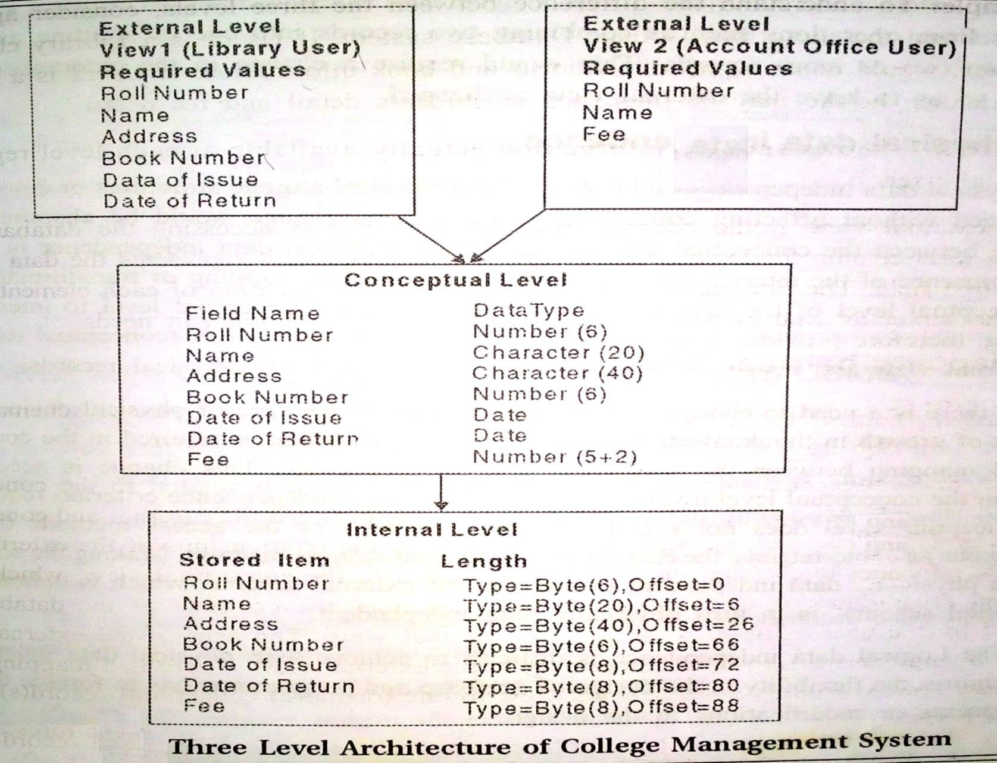
Example

Slide 27
Advantages and Disadvantages of DBMS
Advantages of DBMS
Data Redundancy Elimination: Centralized data management reduces duplication and ensures consistency across the database.
Data Integrity and Accuracy: Enforces constraints (e.g., primary keys) to ensure data validity and consistency.
Data Security: Provides controlled access to sensitive data through user roles and permissions.
Data Independence: Logical and physical data independence allows schema changes without affecting applications.
Backup and Recovery: Automatic recovery mechanisms protect data in case of system failure.

Slide 28
Advantages and Disadvantages of DBMS
Disadvantages of DBMS
High Initial Cost: Requires significant investment in software, hardware, and skilled personnel.
Complexity: DBMS systems can be complex to install, configure, and maintain.
Performance Overhead: System overhead from features like security and abstraction may reduce performance compared to simple file systems.
Training Requirements: Requires specialized training for database administrators (DBAs) and users.
Potential for System Failure: Centralized control can lead to widespread disruptions in case of failure.

Slide 29
Data Independence
The ability to modify a scheme definition in one level without affecting a scheme definition in a higher level is called data independence.
There are two kinds:
Logical data independence
Physical data independence

Slide 30
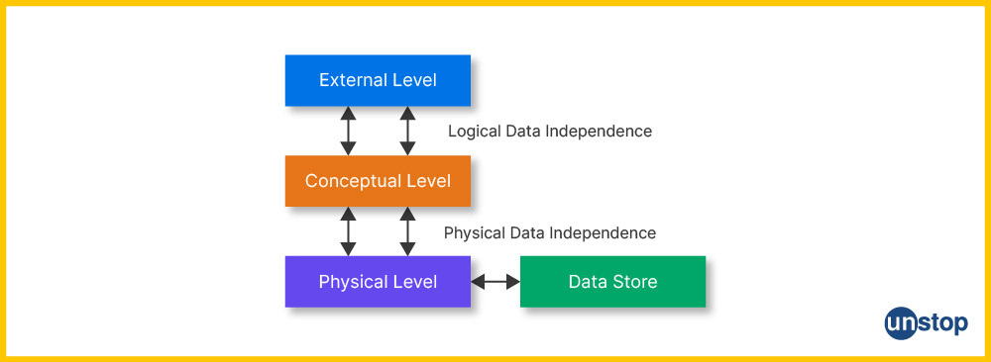
Data Independence in DBMS
In the context of a database management system, data independence is the feature that allows the schema of one layer of the database system to be changed without any impact on the schema of the next higher level of the database system. Through data independence, we can build an environment in which data is independent of all programs, and through the three schema architectures, data independence will be more understandable.

Slide 31
Types of Data Independence
Logical Data Independence
Changing the logical schema (conceptual level) without changing the external schema (view level) is called logical data independence.
It is used to keep the external schema separate from the logical schema.
If we make any changes at the conceptual level of data, it does not affect the view level.
This happens at the user interface level.
For example, it is possible to add or delete new entities, attributes to the conceptual schema without making any changes to the external schema.

Slide 32
Types of Data Independence
Physical Data Independence
Making changes to the physical schema without changing the logical schema is called physical data independence.
If we change the storage size of the database system server, it will not affect the conceptual structure of the database.
It is used to keep the conceptual level separate from the internal level.
This happens at the logical interface level.
Example – Changing the location of the database from C drive to D drive.

Slide 33
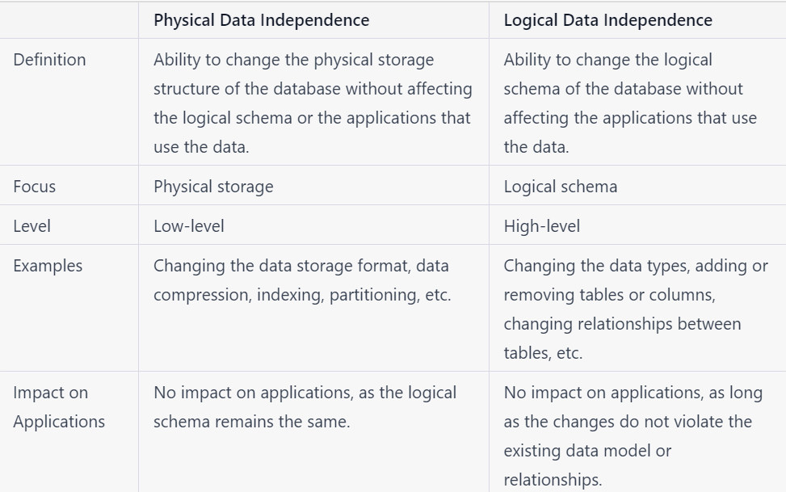

Slide 34
DBA and Responsibilities of DBA
A Database Administrator (DBA) is an individual or person responsible for controlling, maintaining, coordinating, and operating a database management system. Managing, securing, and taking care of the database systems is a prime responsibility. They are responsible and in charge of authorizing access to the database, coordinating, capacity, planning, installation, and monitoring uses, and acquiring and gathering software and hardware resources as and when needed. Their role also varies from configuration, database design, migration, security, troubleshooting, backup, and data recovery. Database administration is a major and key function in any firm or organization that is relying on one or more databases. They are overall commanders of the Database system.

Slide 35
DBA and Responsibilities of DBA
Database Design and Implementation:
Plan and design the database structure, ensuring it meets organizational requirements.
Create schemas, tables, and indexes for efficient data storage and access.
2. Database Security:
Set up user roles and permissions to restrict unauthorized access.
Monitor database activity for potential security breaches.
3. Backup and Recovery:
Implement regular data backups to prevent loss in case of failure.
Design and execute disaster recovery plans for quick restoration.
4. Performance Monitoring and Tuning:
Optimize database performance by fine-tuning queries, indexes, and storage mechanisms.

Slide 36
DBA and Responsibilities of DBA
5. Database Maintenance:
Perform regular updates to keep the system running smoothly.
Clean up outdated or unnecessary data to save storage.
6. Troubleshooting and Problem Resolution:
Diagnose and resolve database errors and performance issues.
Work with developers and IT staff to resolve database-related problems.
7. Database Upgrades and Migration:
Upgrade database systems to newer versions for improved features and security.
Migrate data during system transitions or upgrades.
8. User Support and Training:
Assist users in writing efficient queries.
Provide training to staff on database operations and best practices.
9. Data Integrity:
Enforce constraints to ensure accuracy, consistency, and validity of stored data.

Slide 37
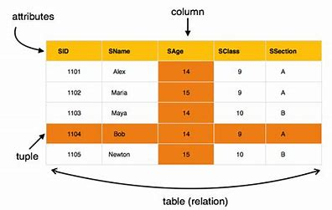
Relational Data Structure
The relational data structure is the backbone of the Relational Database Management System (RDBMS). It organizes data into tables (relations) with rows and columns, making it easier to store, access, and manipulate data.
Key Components of Relational Data Structure:
Relation (Table):
A relation is a two-dimensional structure consisting of rows (tuples) and columns (attributes).
Represents an entity or object, such as Students, Employees, or Products

Slide 38
Relational Data Structure
2. Tuple (Row):
Each row in a table is called a tuple.
Represents a single record or instance of an entity.
3. Attribute (Column):
Represents a single record or instance of an entity.
an attribute.
Represents a property or characteristic of the entity.
Example: SName, SAge, SClass and SSection are attributes of the Student entity.

Slide 39
Relational Data Structure
4. Schema:
The structure of a relation, including the table name, attributes, and their data types.
Example:
Schema of Student: Student(StudentID: INT, Name: VARCHAR, Age: INT, Course: VARCHAR)
5. Instance:
A snapshot of the data in a relation at a specific point in time.
Example: The current data in the Student table is an instance of the relation.

Slide 40
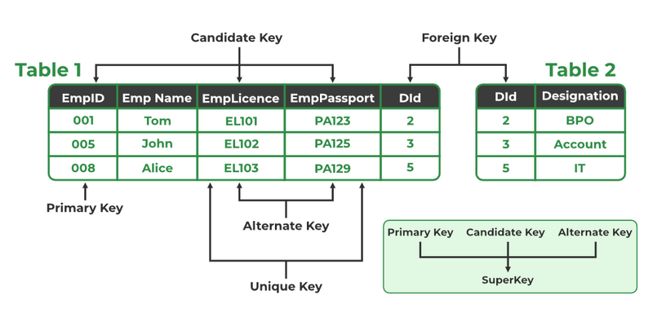
Keys in DBMS
Keys are attributes or sets of attributes that help identify a record (or tuple) uniquely in a database table. They ensure data integrity and establish relationships between tables.
Different Types of Database Keys
Candidate Key
Primary Key
Super Key
Alternate Key
Foreign Key
Composite Key

Slide 41
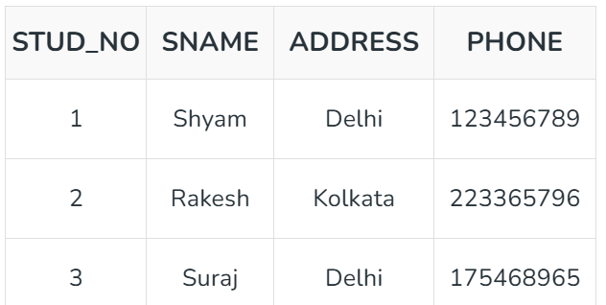
Keys in DBMS
Primary Key
A primary key in a table that uniquely identifies each row and column or set of columns in the table. The primary key is an attribute or a set of attributes that help to uniquely identify the tuples(records) in the relational table. The primary key provides the means to distinguish one tuple from all the others in the relation. It helps the user to identify the location and also the database system to identify, locate, and refer to one particular tuple in the relation.
Example:
STUDENT table -> Student(STUD_NO, SNAME,
ADDRESS, PHONE) , STUD_NO is a primary key

Slide 42
Keys in DBMS
Candidate Key
A candidate key is a minimal set of attributes that uniquely identifies each tuple within a table. In other words, there should not be any two rows in a table that can have the same values for the columns that are the part of candidate key. It is very important for establishing relationships between tables and maintaining data integrity. Candidate keys play a pivotal role in database normalization as they help us to eliminate data redundancy and anomalies.
Example:
STUD_NO is the candidate key for relation STUDENT.

Slide 43
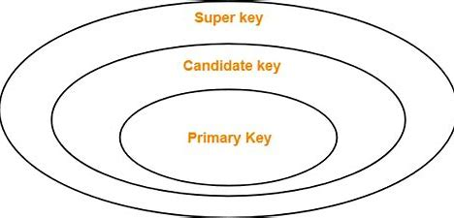
Keys in DBMS
Super Key
We can define a super key as a set of those keys that identify a row or a tuple uniquely. The word super denotes the superiority of a key. Thus, a super key is the superset of a key known as a Candidate key. The role of the super key is simply to identify the tuples of the specified table in the database. It is the superset where the candidate key is a part of the super key only.
Example:
STUD_NO+PHONE is a super key.

Slide 44
Keys in DBMS
Composite Key
Sometimes, a table might not have a single column/attribute that uniquely identifies all the records of a table. To uniquely identify rows of a table, a combination of two or more columns/attributes can be used. It still can give duplicate values in rare cases.
Example:
FULLNAME + DOB can be combined together to access the details of a student.

Slide 45
Keys in DBMS
Foreign Key
If an attribute can only take the values which are present as values of some other attribute, it will be a foreign key to the attribute to which it refers. The relation which is being referenced is called referenced relation and the corresponding attribute is called referenced attribute.
Example:
Refer Table STUDENT shown above.
STUD_NO in STUDENT_COURSE is a foreign key to STUD_NO in STUDENT relation.

Slide 46
Keys in DBMS
Alternate Key
The candidate key other than the primary key is called an alternate key .
All the keys which are not primary keys are called alternate keys.
It is a secondary key.
It contains two or more fields to identify two or more records.
These values are repeated.
Example:
Consider the table shown above.
STUD_NO, as well as PHONE both,
are candidate keys for relation STUDENT but
PHONE will be an alternate key
(only one out of many candidate keys).

Slide 47

Keys in DBMS

Slide 48
Integrity Constraints
Integrity constraints are rules used in database systems to maintain the accuracy, consistency, and validity of the data stored in a database. They ensure that the data adheres to certain conditions and business rules, thereby preventing invalid or corrupt data from being entered or manipulated.
Entity Integrity: Entity integrity ensures that every table has a primary key and that the values in the primary key column(s) are unique and not NULL. This guarantees that every row in the table can be uniquely identified.
Rules of Entity Integrity:
A table must have a primary key.
The primary key values cannot be NULL.
The primary key must uniquely identify each record.

Slide 49
Integrity Constraints
Referential Integrity: Referential integrity ensures that a foreign key in one table matches a valid primary key in another table. This maintains the relationship between tables and prevents invalid references.
Rules of Referential Integrity:
A foreign key value must either:
Match a primary key value in the referenced table, or
Be NULL (if the relationship allows null foreign keys).
A foreign key cannot reference a non-existent primary key.
Domain Integrity: Ensures that data values in a column must belong to a specific domain (set of valid values or data types).
Rules of Domain Integrity:
Each column must have a valid data type (e.g., integer, text, date).
Column values must fall within the defined range or set of acceptable values.
Disallowed values violate domain integrity.

Slide 50
Book References
Textbooks
Ramez Elmasri and Shamkant B. Navathe, “Fundamentals of Database System”, The Benjamin / Cummings Publishing Co.
Korth and Silberschatz Abraham, “Database System Concepts”, McGraw Hall.
Pratt,” DBMS”, Cengage Learning
Reference books
C.J.Date, “An Introduction to Database Systems”, Addison Wesley.
Thomas M. Connolly, Carolyn & E. Begg, “Database Systems: A Practical Approach to Design, Implementation and Management”, 5/E, University of Paisley, Addison-Wesley.
Rob,” Database Principal Fundamental Design, Cengage Learning

Slide 51
THANK YOU

